Slide 1
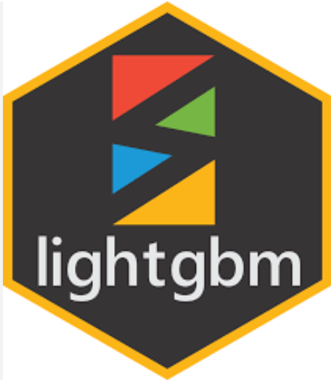
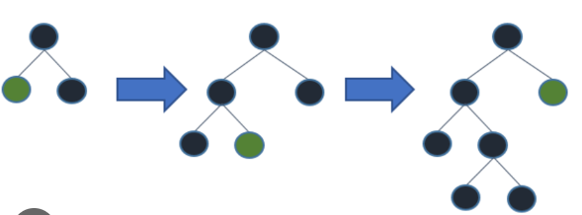
LIGHTGBM
20MIA1031
Sanjay.M

Slide 2

INTRODUCTION
LightGBM is a gradient boosting framework that uses tree based learning algorithms.
It is designed to be distributed and efficient with the following advantages:
Faster training speed and higher efficiency.
Lower memory usage.
Better accuracy.
Support of parallel, distributed, and GPU learning.
Capable of handling large-scale data.
LightGBM is a Supervised ensemble Machine Learning algorithm.

Slide 3
.
Why is LightGBM popular?
It has become difficult for the traditional algorithms to give results fast, as the size of the data is increasing rapidly day by day.
LightGBM is called “Light” because of its computation power and giving results faster.
.
LightGBM is known to be both more efficient and scalable.
It performs very well on small datasets as well as on large ones.
What is LightGBM used for?
LightGBM is a gradient boosting ensemble method that is used by the Train Using AutoML tool and is based on decision trees.
As with other decision tree-based methods, LightGBM can be used for both classification and regression.
LightGBM is optimized for high performance with distributed systems.

Slide 4
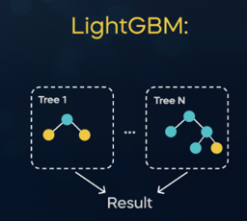
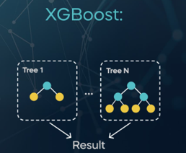
How is LightGBM different from XGBoost?
LightGBM uses a novel technique of Gradient-based One-Side Sampling (GOSS) to filter out the data instances for finding a split value.
while XGBoost uses pre-sorted algorithm & Histogram-based algorithm for computing the best split.
Is lgbm faster than XGBoost?
There has been only a slight increase in accuracy and auc score by applying Light GBM over XGBOOST but there is a significant difference in the execution time for the training procedure.
Light GBM is almost 7 times faster than XGBOOST and is a much better approach when dealing with large datasets.
A properly-tuned LightGBM will most likely win in terms of performance and speed compared with random forest
High value of estimators for random forest will affect it robustness, where as for GBM model will improve the model fit with your training data

Slide 5
.
Can LightGBM overfit?
LightGBM uses the leaf-wise tree growth algorithm, while many other popular tools use depth-wise tree growth.
Compared with depth-wise growth, the leaf-wise algorithm can converge much faster.
However, the leaf-wise growth may be over-fitting if not used with the appropriate parameters.
.
How does LightGBM treat null values?
In lightgbm for categorical variables, "all negative values will be treated as missing values".
So the reason for often using values like -999 for null/na values is because of convention + usage of tree based algorithms like xgb/lgb.
What makes LightGBM lightning fast?
There are three reasons why LightGBM is fast: Histogram based splitting, Gradient-based One-Side Sampling (GOSS), Exclusive Feature Bundling (EFB)

Slide 6
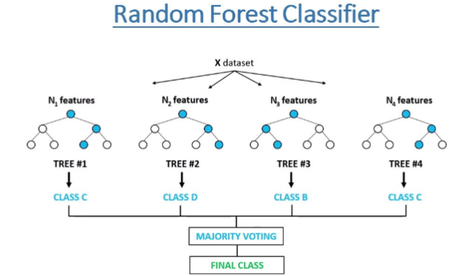
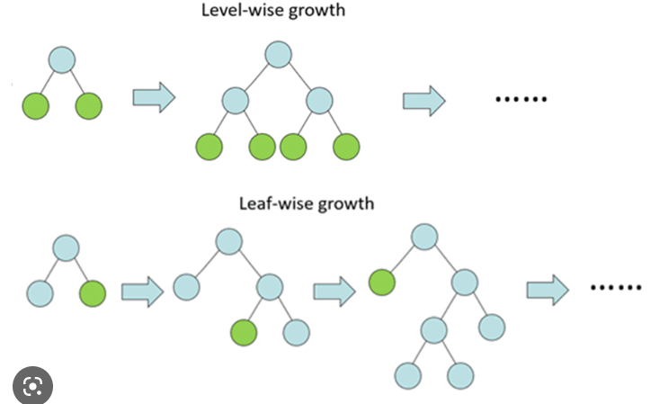
Light GBM use histogram based algorithm i.e it buckets continuous feature values into discrete bins which fasten the training procedure.
Lower memory usage: Replaces continuous values to discrete bins which result in lower memory usage.
XGBoost was based on a level-wise growth algorithm

Slide 7
CatBoost
CatBoost (Categorical Boosting) is a machine learning algorithm that is designed specifically to work with categorical features and overcome some of the limitations of traditional gradient boosting methods.
CatBoost can handle both numerical and categorical data, and automatically detects which features are categorical. It uses a variant of gradient boosting called gradient-based one-side sampling (GOSS) that reduces the amount of data that needs to be processed during training.
This makes it faster and more memory-efficient than traditional gradient boosting methods.
Some key features of CatBoost include:
Automatic handling of categorical features: CatBoost can automatically convert categorical features into numerical representations, without the need for one-hot encoding.
Built-in feature importance calculation: CatBoost can calculate feature importance based on the contribution of each feature to the model's performance.
GPU support: CatBoost can be run on GPUs, which can significantly speed up training time for large datasets.
Some potential benefits of using CatBoost include:
Improved accuracy
Reduced processing time

Slide 8
Gradient Boosting Regressor
Gradient Boosting Regressor (GBR) is a machine learning algorithm that belongs to the boosting family of ensemble methods. It works by combining multiple weak learners into a single strong learner in an iterative fashion. In each iteration, the algorithm builds a new model that tries to correct the errors made by the previous models.
GBR is a powerful algorithm for regression tasks as it can handle both linear and nonlinear relationships between the features and the target variable. It can also handle missing values and outliers in the data. GBR is based on the principle of gradient descent, which involves minimizing the loss function by adjusting the model's parameters in the direction of the negative gradient.
The main hyperparameters of GBR are the number of trees in the ensemble, the learning rate, and the maximum depth of the trees. The number of trees controls the complexity of the model and the learning rate controls the step size taken in the gradient descent. The maximum depth of the trees controls the level of interaction between the features.
Some of the advantages of GBR include:
High accuracy: GBR is a powerful algorithm that can achieve high accuracy on regression tasks.
Robustness: GBR is robust to outliers and can handle missing values in the data.
Flexibility: GBR can handle both linear and nonlinear relationships between the features and the target variable.
Interpretability: GBR can provide feature importance scores that can be used to interpret the model.

Slide 9
SVM
Support Vector Machine (SVM) is a popular machine learning algorithm used for classification and regression analysis.
It is a supervised learning algorithm that analyzes data and recognizes patterns, then assigns new data points to the correct category or group.
SVM works by finding a hyperplane in a high-dimensional space that separates the different classes. The hyperplane is chosen in such a way that it maximizes the margin between the closest points of the different classes.
This margin is the distance between the hyperplane and the closest data points of each class. The points closest to the hyperplane are called support vectors.
Another advantage of SVM is its ability to handle high-dimensional data with a small number of samples.
SVM performs well on datasets with many features, but fewer samples, as it focuses on the points closest to the decision boundary and ignores the other data points.
SVM has several applications in various fields such as image classification, text classification, bioinformatics, and finance. Its high accuracy and ability to handle complex data make it a powerful tool in machine learning.

Slide 10
ANN
ANN stands for Artificial Neural Network, which is a type of machine learning model that is inspired by the structure and function of the biological neural networks in the human brain.
ANNs are composed of layers of interconnected nodes or artificial neurons, which are organized into an input layer, one or more hidden layers, and an output layer.
Each neuron receives input from the neurons in the previous layer, and applies a transformation to produce an output that is passed on to the neurons in the next layer.
The connections between neurons are associated with weights, which are adjusted during the training process to minimize a loss function that measures the difference between the predicted output of the network and the true output.
ANNs have been successfully applied to a wide range of tasks, including image and speech recognition, natural language processing, and predictive modeling in various domains such as finance, healthcare, and marketing.
The advantage of using an ANN is that it can learn complex relationships between the input features and the target variable, and it can handle a large amount of data. However, it requires a lot of data to train, and it may overfit the data if not regularized properly.

Slide 11


